Slide 1
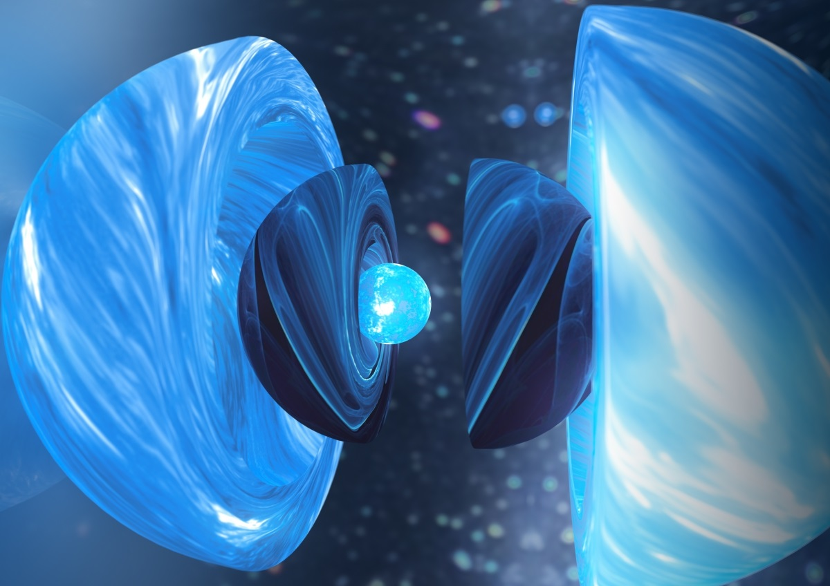



Compact Objects and Dense Matter: Probing Neutron Star Interiors
Devarshi Choudhury
PhD Candidate D.Choudhury@uva.nl

Slide 2
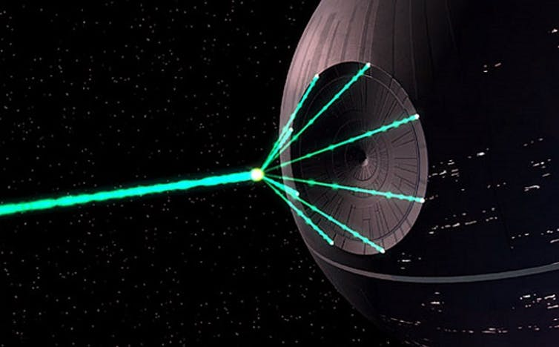

Death Stars

Slide 3
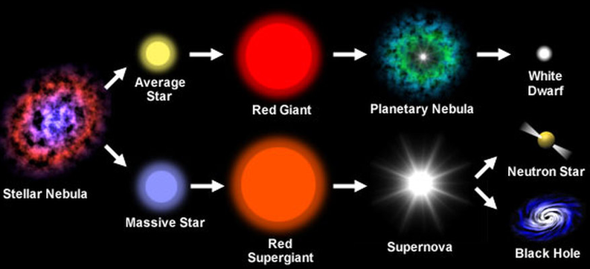
Death of Stars
Notes:
Right so since a star is born, it has a life cycle where it evolves and then eventually dies. This evolution process was covered by Aman in the lecture on stellar evolution.
Their deaths lead to the formation of the some of the most exotic and mind-bending objects in the universe
The kind of object that forms depends on how massive the stars are once they’ve formed – for a low mass star, the ultimate end form is known as a white dwarf. This is what our sun will turn into down the line and for high mass stars, they can be a bit of diva and explode in the form of a supernova and either form a neutron star or a black hole.
Now before we explore how and why these stars end up at such different stages when they die, I wanna touch upon the scale of these objects

Slide 4
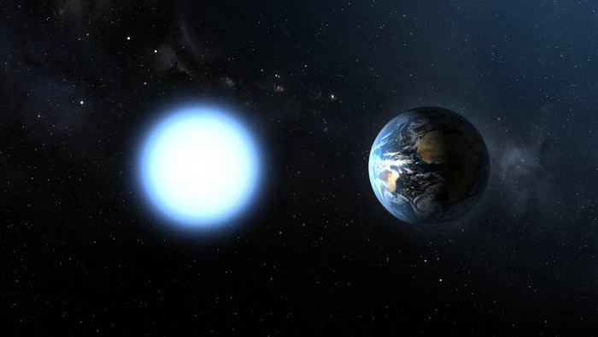
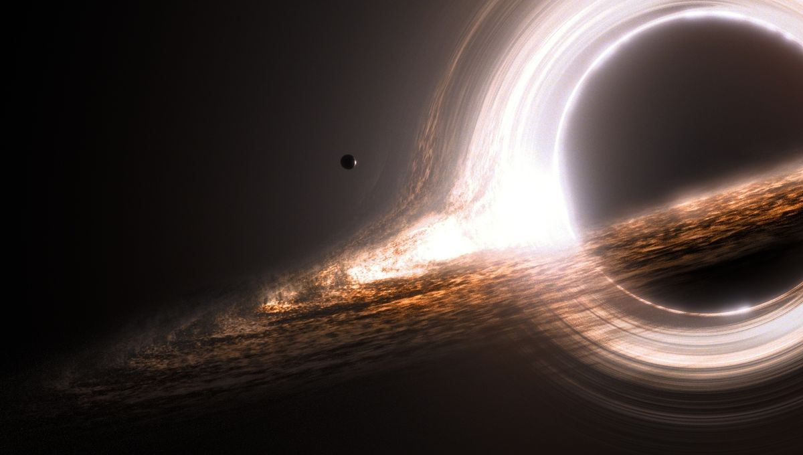
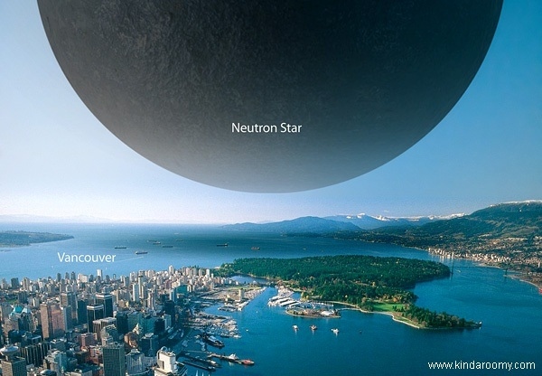
Compact Objects
Notes:
So these stars are called compact objects for a reason.
WD – solar mass, earth-like but a spoonful is as heavy as a family car
NS – can be 2-3 solar mass, size of a city, spoonful = Everest
BH – dense matter is an understatement, whether matter that is engulfed is even in material state is unknown, so in this talk we’ll focus on the former two which are objects we can make some sense, have ultra-compressed dense matter and are directly observable
Alright, with that in mind, back to stellar evolution

Slide 5
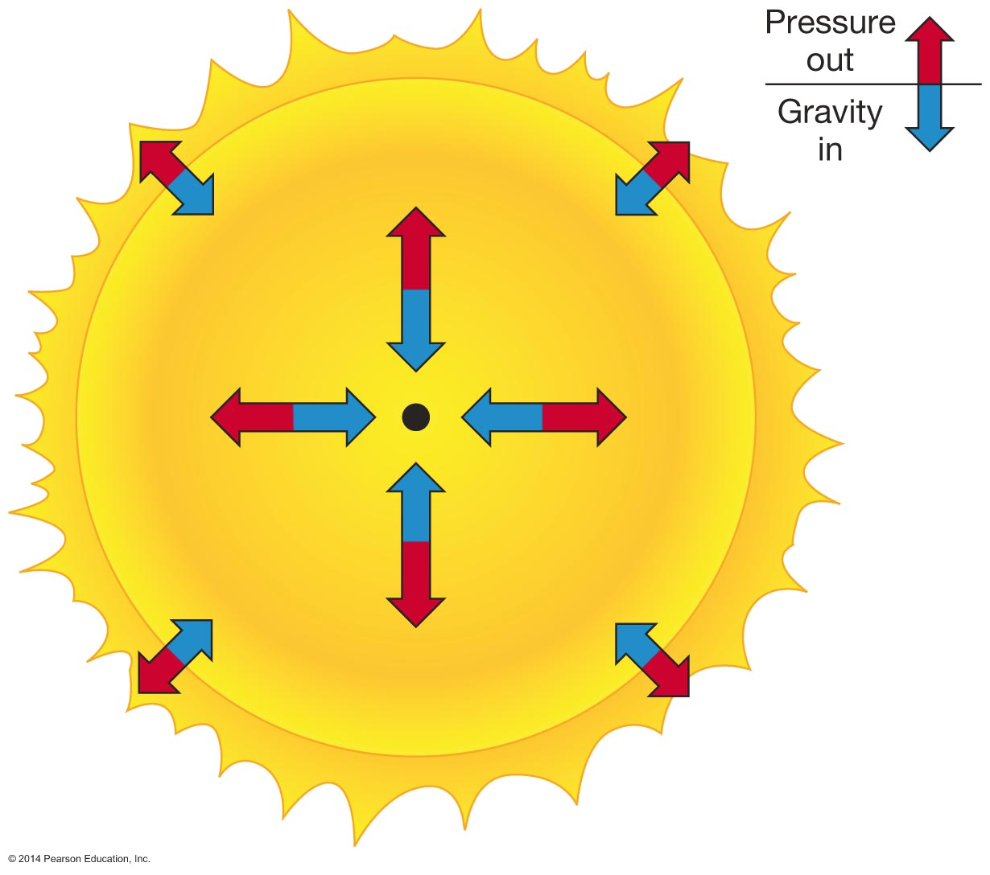
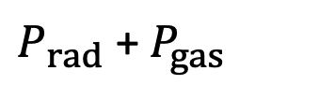
Hydrostatic Equilibrium
$P_{rad}$ + $P_{gas}$
Fuel Depletion – gravity begins to dominate
Core contracts and heats up
Core material begins fusion
Notes:
So as you have seen in the previous lectures, a star’s weight is supported against its own gravity by means of nuclear fusion processes taking place in the core, i.e it is in hydrostatic equilibrium where the gas pressure and radiation pressure are keeping it stable.
Once a star is born, it is happily fusing away hydrogen into helium at its core, but life is not a bed of roses and there comes a stage where the star has exhausted most of its fuel, the hydrogen in its core, which has turned into helium
But the temperature is not high enough for helium to ignite. As a result, gravitational pressure begins to dominate and the core contracts. This contraction increases the pressure and density and assuming we are in the ideal gas regime, there’ll be a rise in temperature and once it’s high enough to ignite helium, another fusion stage begins with helium burning at the core of the star forming large quantities of carbon and oxygen

Slide 6
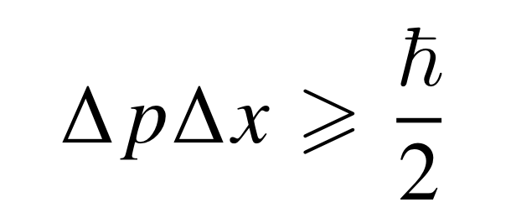
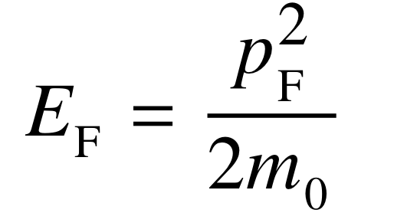
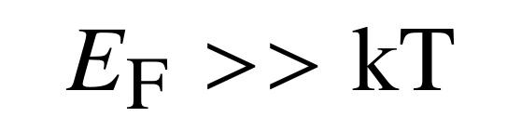
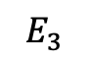
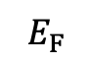
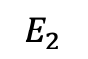
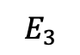
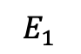
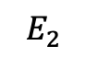
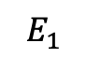
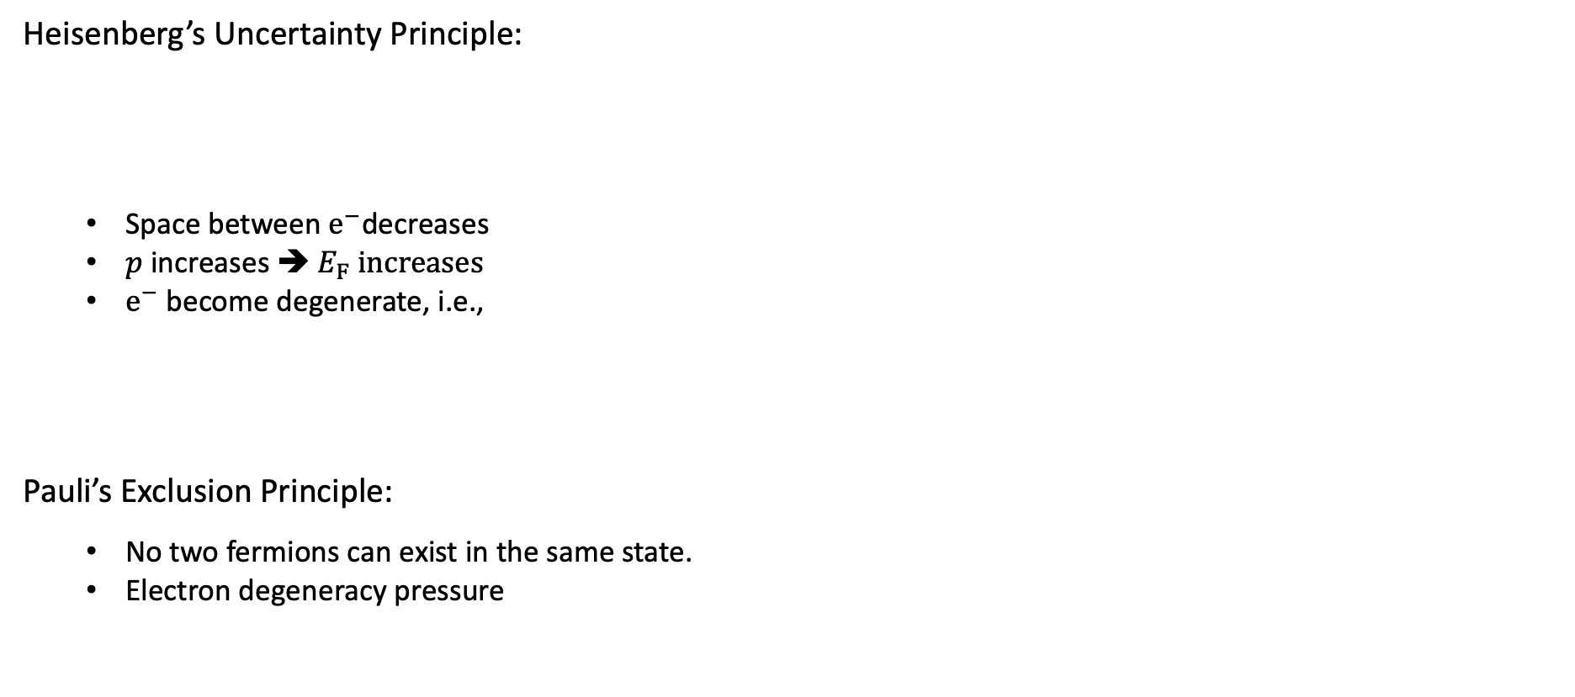
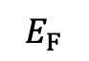
Low Mass Regime (< 8 $M_{⊙}$)
Heisenberg’s Uncertainty Principle:
Space between${ e}^{−}$decreases
$p$ increases ➔$E_{F}$ $increases$
$e^{−}$ become degenerate, i.e.,
Pauli’s Exclusion Principle:
No two fermions can exist in the same state.
Electron degeneracy pressure
$$E_{F}$$
$$E_{F}$$
$$E_{3}$$
$$E_{3}$$
$$E_{2}$$
$$E_{2}$$
$$E_{1}$$
$$E_{1}$$
Notes:
So, let’s first consider a low mass or average mass star like the sun (by the average star is likely to be of this mass range).
Just like before, Pgrav dominates, the core which is now primarily C and O starts shrinking as had happened before leading to a rise in pressure, but now there are other interesting consequences to this increase
There are quantum mechanical effects that come into play. Let’s recall the Heisenberg’s principle – position and momentum cannot be simultaneously be determined. As we increase the pressure, the distance between the particles are getting reduced and their position in space are becoming more and more well-defined
Ef increases much quicker with increase in pressure than the rise in thermal temperature and so the system is considered to be effectively at zero temperature, and we can say that there’s no effective increase in the thermal temperature
Because of Pauli’s exclusion principle, electrons are in their lowest energy states. Further compression causes this to resist the increase in pressure, and this effect is known as electron degeneracy pressure.

Slide 7
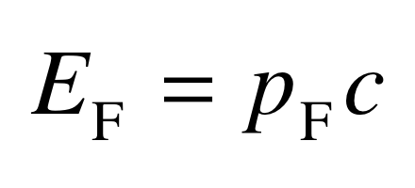
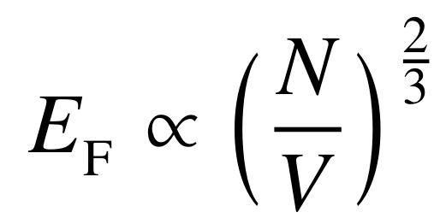
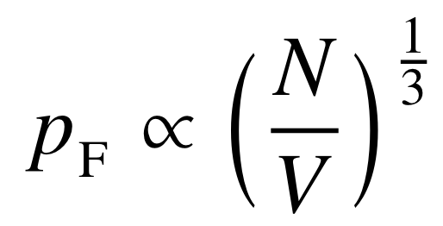
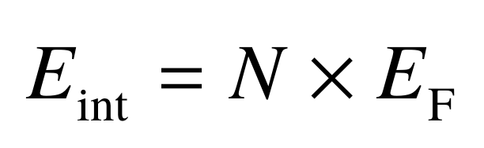
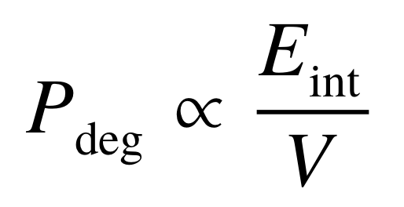
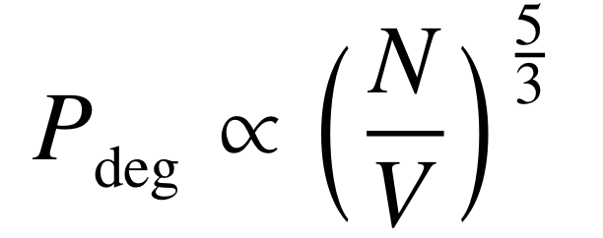

Degenerate Equation of State (EOS)
Non-relativistic:
Ultra-relativistic:
1.
1.
2.
➔
2.
➔
3.
3.
4.
➔
4.
➔
Notes:
Equation of state are equations that dictate the state of the system and are governed by pressure, thermal temp and density. Temp drops out. Rel btw P and rho
As the density increases, the momentum increases and comes close to the value mc and SR effects kick in

Slide 8
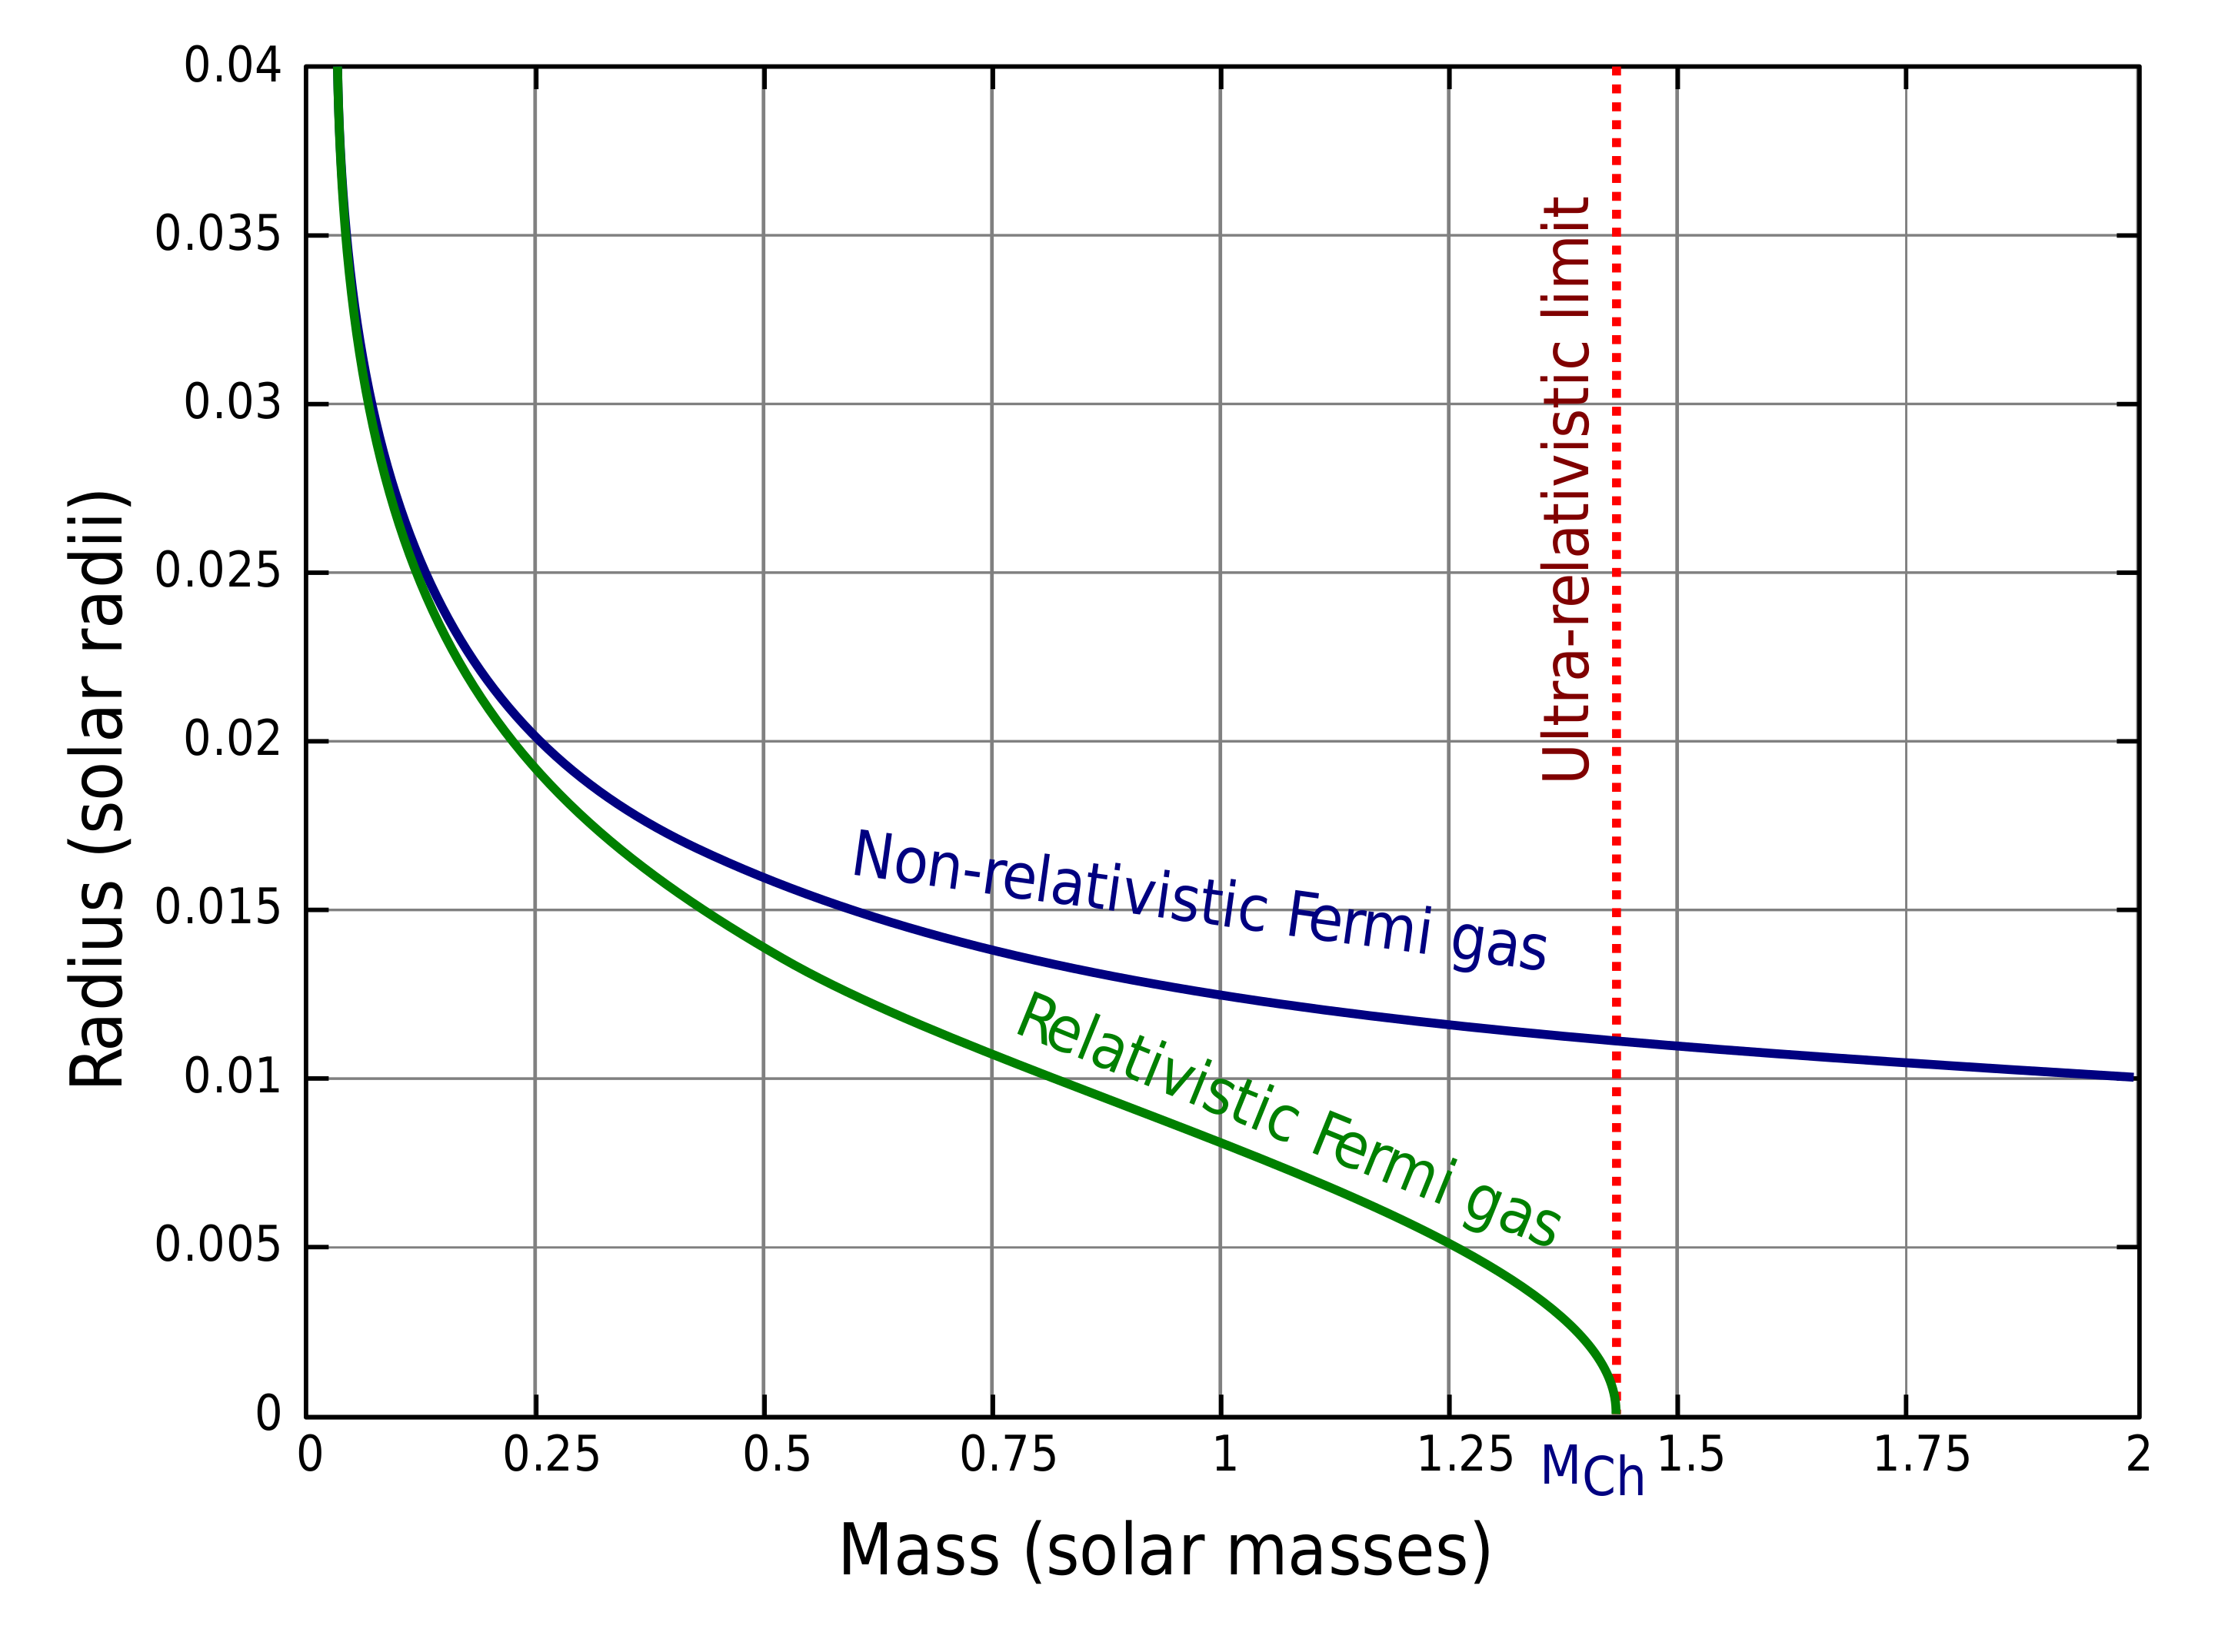
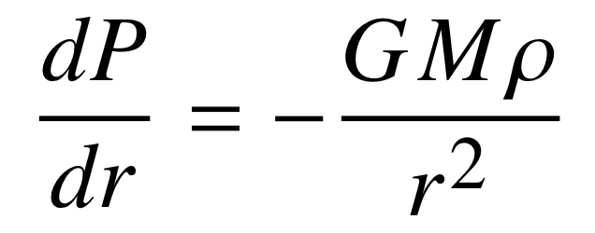
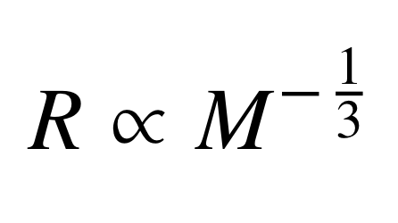
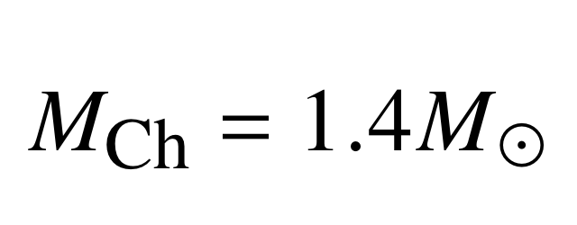
Chandrasekhar Limit
Non-relativistic scenario:
Ultra-relativistic scenario:
Notes:
Expressions for pressure, equate it against the Pgrav
Ultra-relativistic scenario, solving for this differential equation, radius cancels out and a fixed mass value is obtained

Slide 9
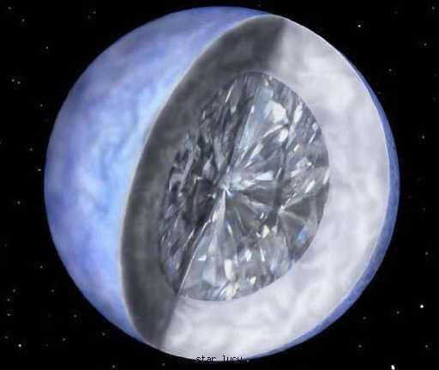
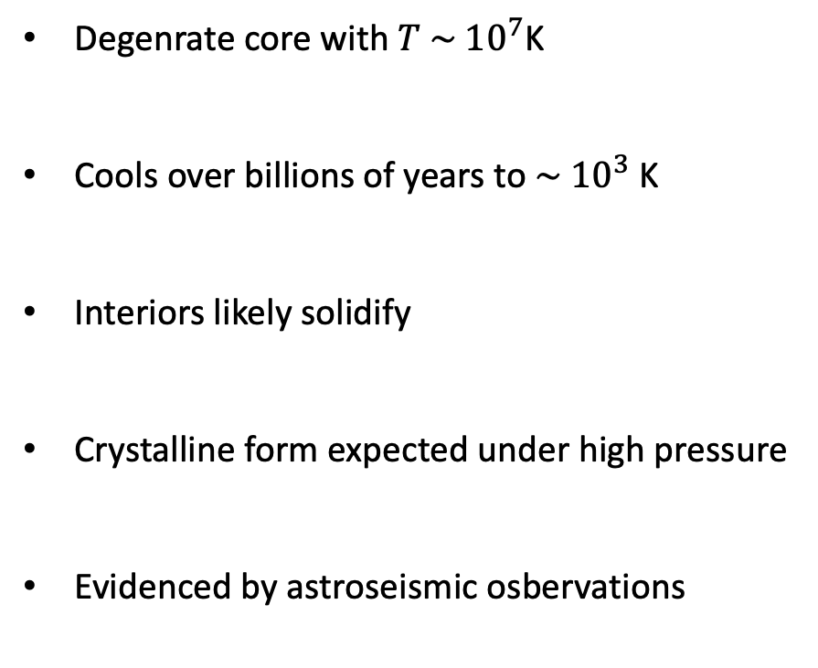
Lucy in the Sky with Diamonds
Degenrate core with $T \sim {10}^{7}$K
Cools over billions of years to $\sim {10}^{3}$ K
Interiors likely solidify
Crystalline form expected under high pressure
Evidenced by astroseismic osbervations
BPM 37093 aka Lucy
Notes:
So, I wanna talk about Lucy, not referring to Lysergic acid diethylamide
So, now that fusion has halted for good and provided we don’t exceed the Chandrasekhar limit, we are left the degenrate CO core of the star known as a white dwarf and rest of the star, the envelope has expanded during the giant phase and is no longer bound to the system

Slide 10
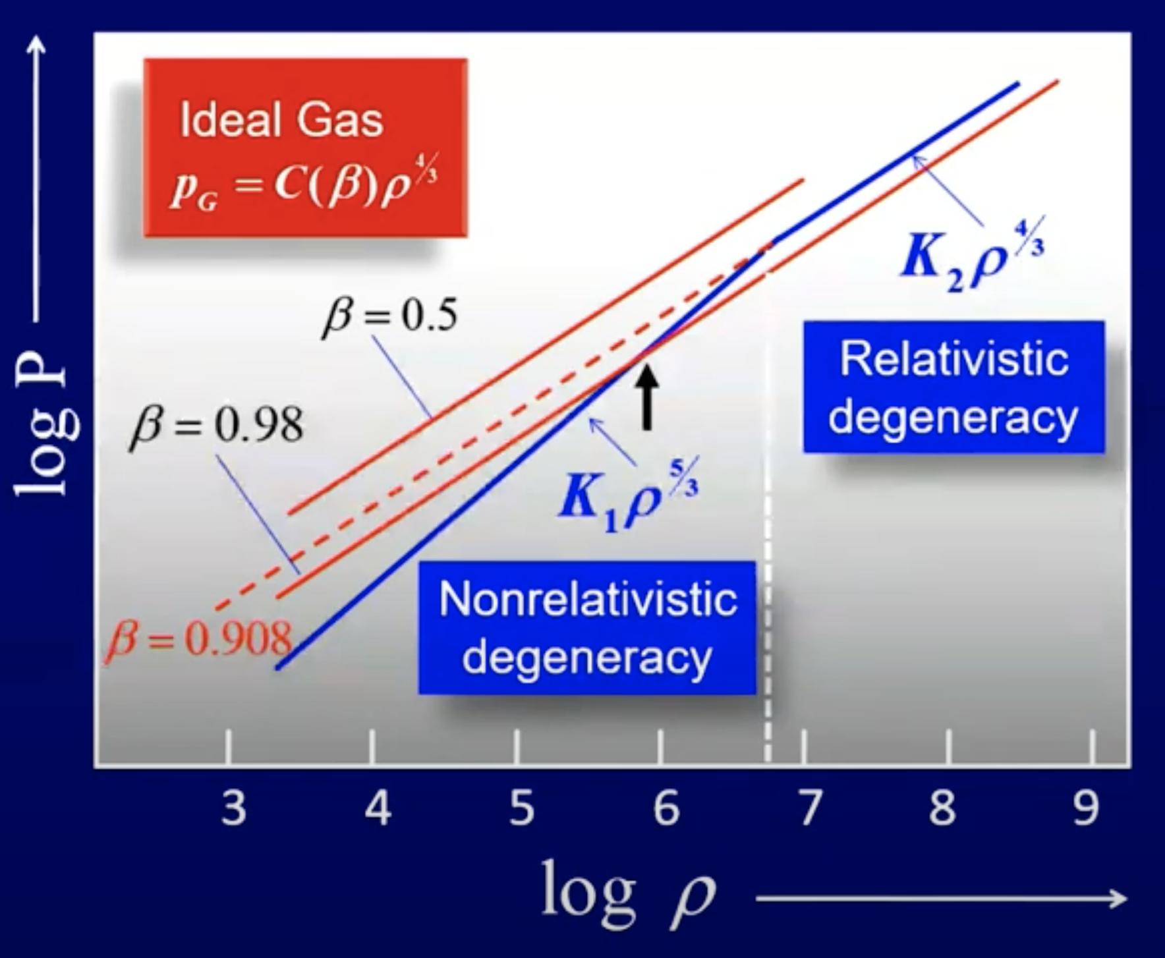
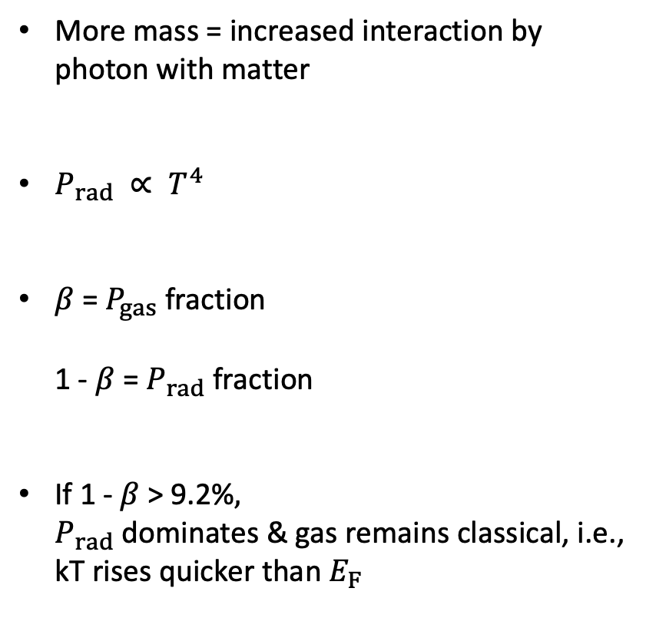
High Mass Regime
More mass = increased interaction by photon with matter
$P_{rad} ∝ T^{4}$
$β$ = $P_{gas}$ fraction 1 - $β$ = $P_{rad}$fraction
If 1 - $β$ > 9.2%$,$ $P_{rad}$ dominates & gas remains classical, i.e., kT rises quicker than $E_{F}$
Notes:
Now that we have briefly covered the end state of low mass stars, let’s look into the high mass regime
You have probably heard before that fusion continues in massive stars into even heavier elements. But then why is it that only massive stars are able to do so? We just saw that upon core contraction, instead of igniting like Helium, matter turns degenerate. Well, why doesn’t this happen for heavier stars then? How do they get to initate C and O ignition?
Increased interaction means that the photon mean free path is now shorter and it takes longer to escape and cool the system.

Slide 11
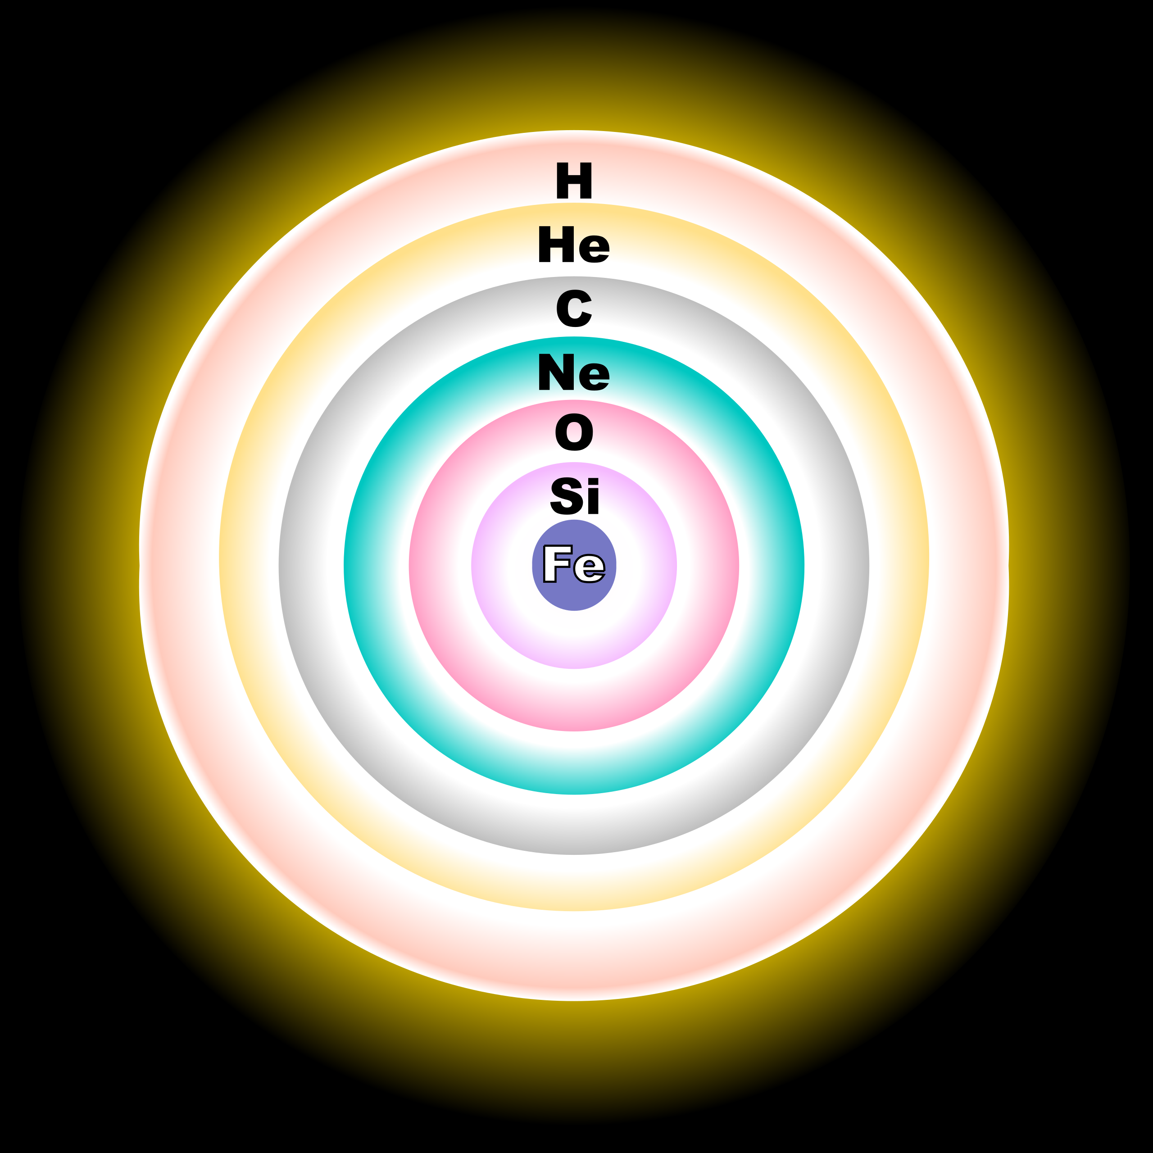
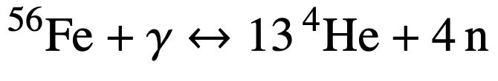
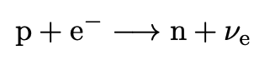
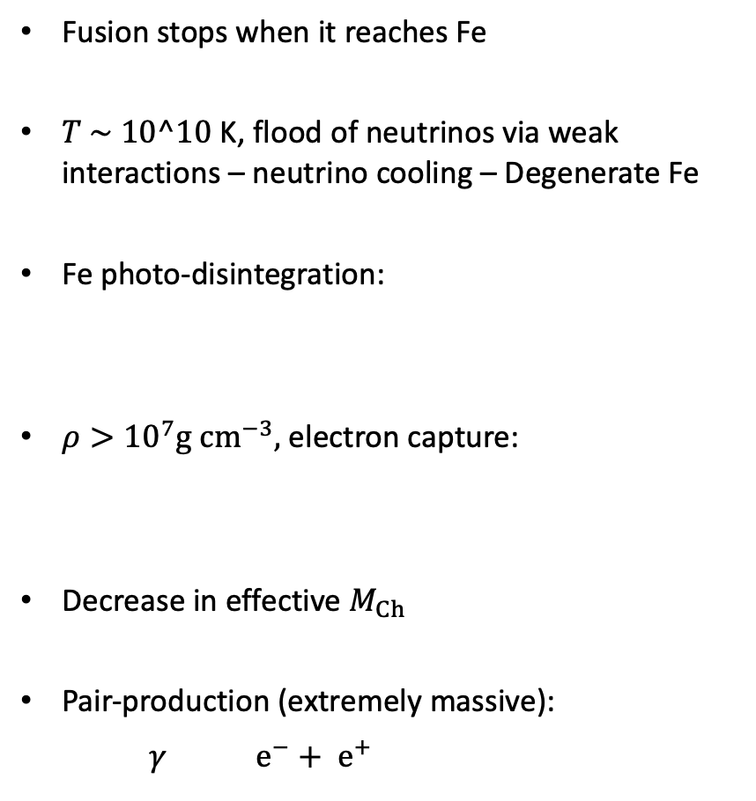
High Mass Regime
Fusion stops when it reaches Fe
$T \sim 10^10$ K, flood of neutrinos via weak interactions – neutrino cooling – Degenerate Fe
Fe photo-disintegration:
$ρ>{10}^{7}g cm^{−3},$electron capture:
Decrease in effective $M_{Ch}$
Pair-production (extremely massive):
$γ$ $e^{−}+ e^{+}$
Notes:
Fusion through stages
Lots of things begin to happen when the star starts producing iron
Decrease in M_Ch since the number of electrons decrease due to electron capture, thus the degeneracy pressure which is dependent on N decreases
All the processes take place in various degrees and are dependent on a multitude of factors including the mass. The end result is usually the same, i.e supernova.

Slide 12
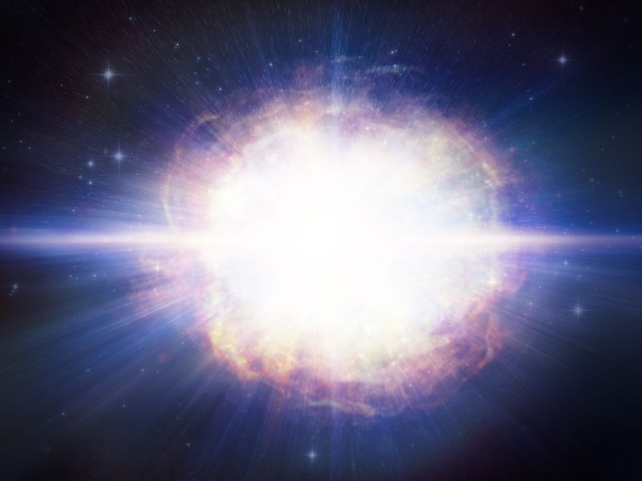
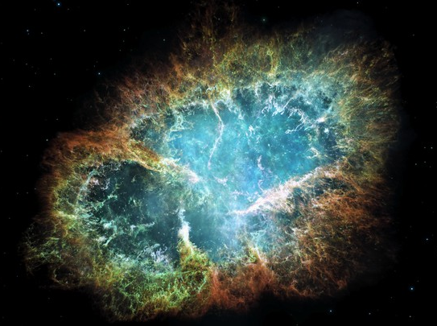
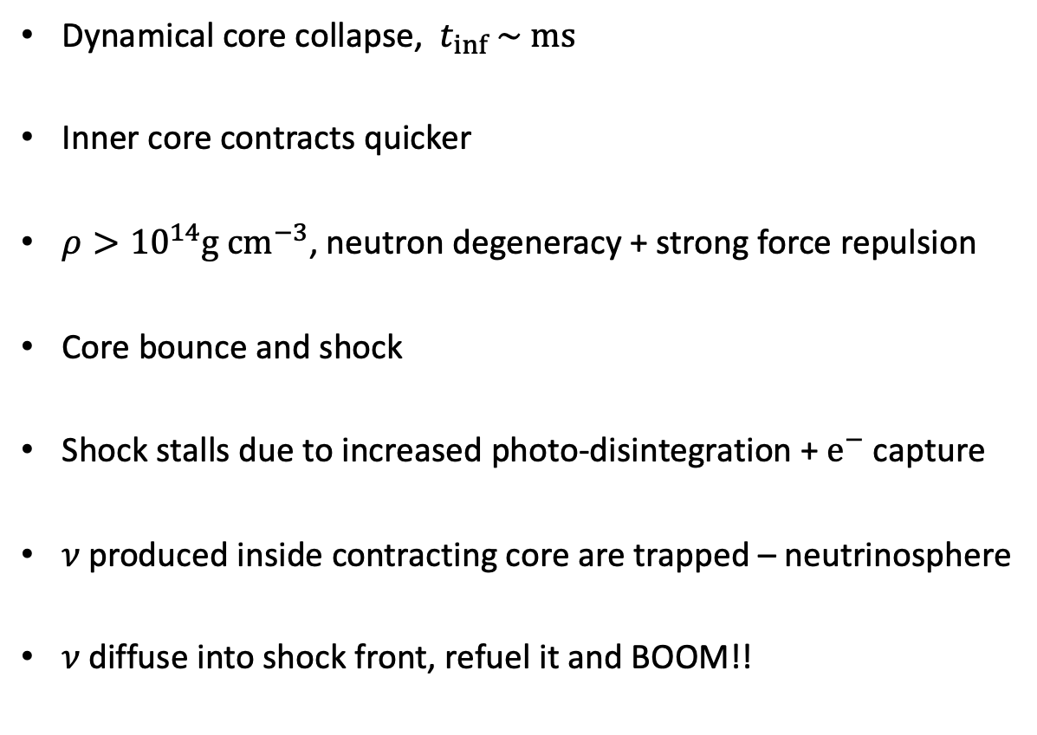
Supernova
Dynamical core collapse, $t_{inf} \sim ms$
Inner core contracts quicker
$ρ>{10}^{14}g cm^{−3}$, neutron degeneracy + strong force repulsion
Core bounce and shock
Shock stalls due to increased photo-disintegration + $e^{−}$ capture
𝜈 produced inside contracting core are trapped – neutrinosphere
𝜈 diffuse into shock front, refuel it and BOOM!!
Notes:
Why do they result in a supernova? Drop in radiation pressure, MCh drop and excess

Slide 13
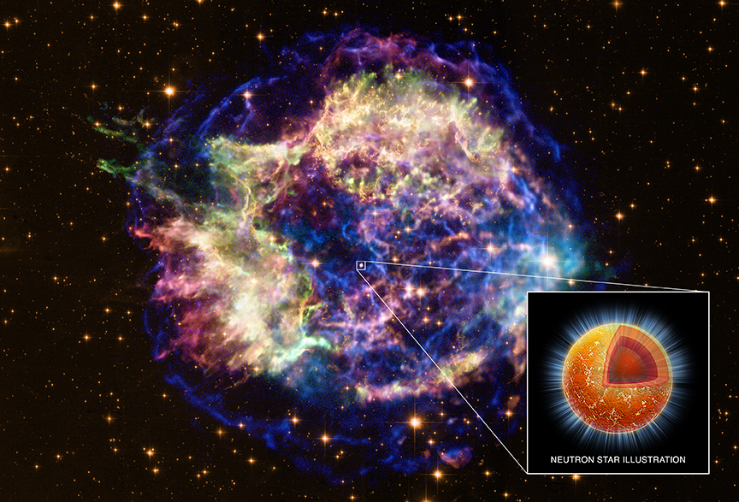
Neutron Stars
Cas A
Notes:
Chandra X-ray image

Slide 14
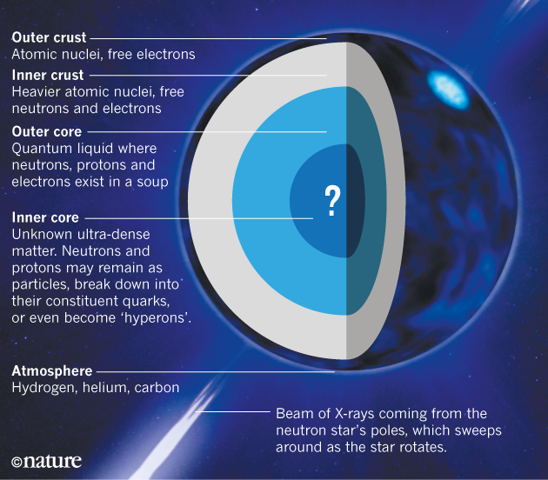
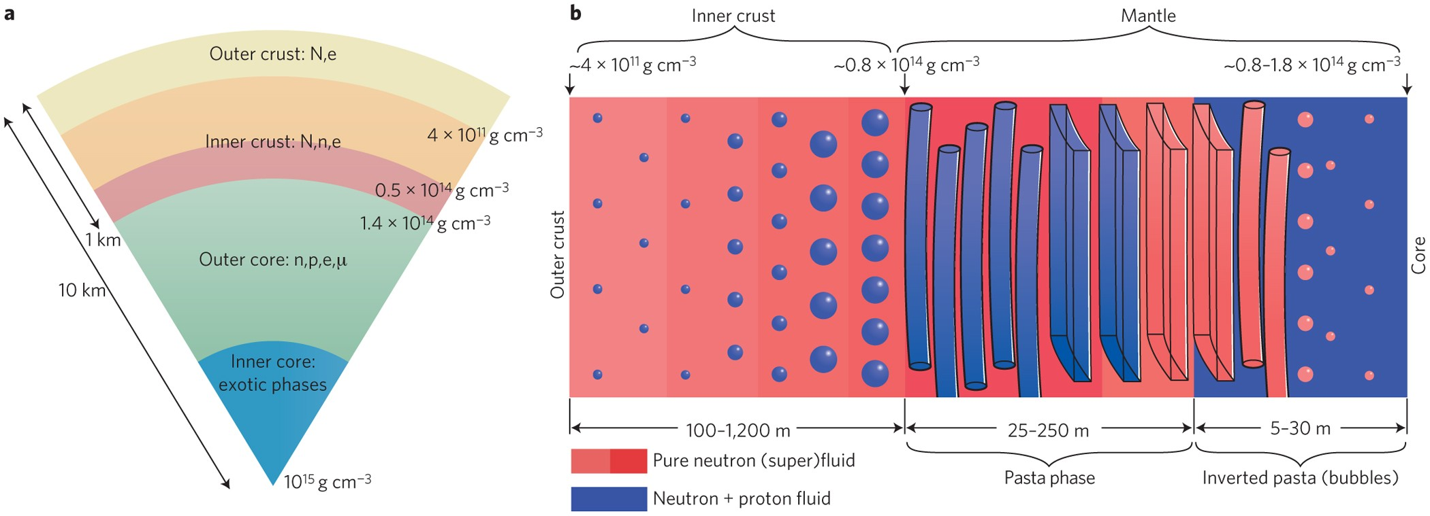
Neutron Star Structure
Notes:
We expect the formation of a thin atmosphere that is a few centimeters in thickness.
Crust is a solid ionic lattice mostly made of iron in the outer part because of the high density, which is embedded in a sea of degenerate electrons.
Going deeper, the density increases sharply and more and more electrons are captured and converted into neutron, resulting in heavier elemental nuclei
But there is a ratio of how many protons:neutrons a nucleus can accommodate. The inner crust is demarcated by densities where neutron drip begins, meaning that the nuclei get so heavy that neutrons drip out of the nuclei and you get fluidic neutron structure shown here in red
As these heavy nuclei are packed close to each other, they begin touching and start forming blobs due to Coulomb repulsion and strong force attraction, which then transform into elongated structures with further increase in density, and we start getting what are essentially known as nuclear pasta – sphagetti, lasagna. As we approach the core, the density is close to nuclear densities and now almost all the matter is in a homogenous state, there are no defined nuclei and you have these pockets of neutronic fluid – swiss cheese. Nuclear pasta also plays a role during the supernova explosion. They determine how long the neutrinos trapped in the core take to escape. Their effects are something that physicists are trying to simulate. These pasta structures can also form lumps and if massive enough, they become sources of continuous GW sources as they rotate and this is something LIGO is actively searching for.
The nature of matter under nuclear saturation conditions are expected to be superconductive (zero electrical resistance, magnetic fields expelled) or superfluidic (zero viscosity, no loss of energy as they flow and move)
With further rise in density, i.e supranuclear densities, we can no more simulate the conditions. Strong force repulsion is poorly understood under such low temperature high density regimes. QCD simulations aren’t possible due to the Fermion sign problem – expectation value of fermionic operator

Slide 15
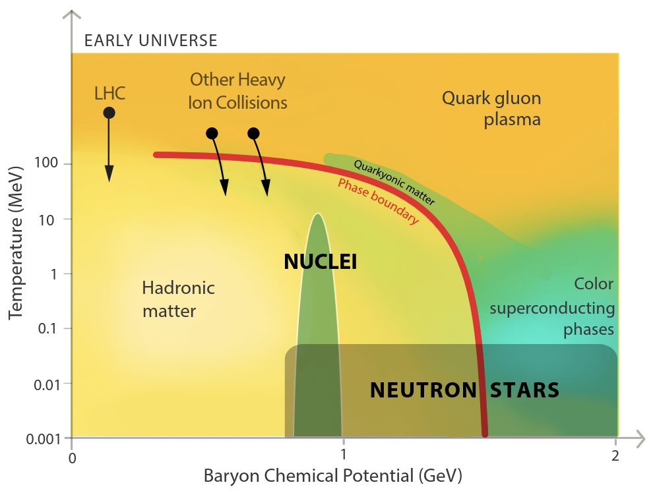
Cold Dense Matter
Watts et al. 2016
Notes:
Phase diagram for dense matter – cold dense matter

Slide 16
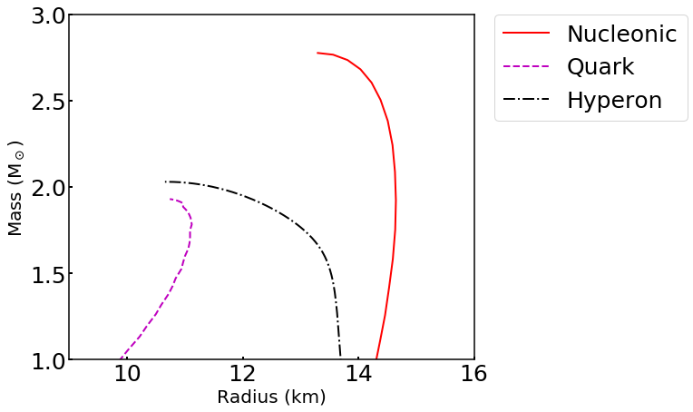
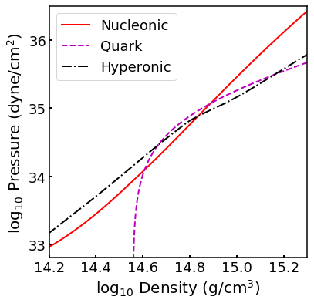
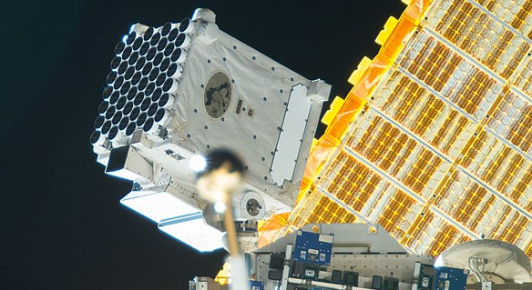
Nuclear Physics ⬄ Spacetime
Equation of state
Mass–radius
TOV equation
Dense matter physics
X-Ray data
Neutron
Hyperon
Notes:
Pressure and density related to mass and radius through relativistic stellar structure equations (TOV).
Describe the exterior ST.
Light from NS encodes info about the bent space time through which it traverses, alongside spin info.

Slide 17
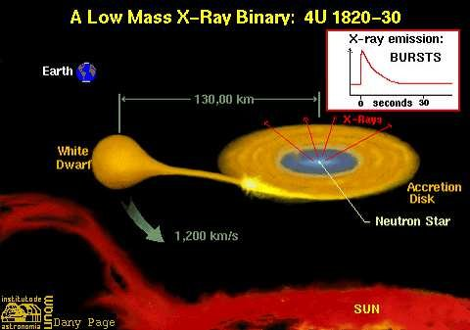
Previous Mass and Radius Measurements
Mass from orbital dynamics
Radius trickier to obtain – spectral modelling during quiescence and outburst
Notes:
LMXBs – well-established relativistic orbital dynamics allows us to accurately determine the masses of objects in a binary which I think Surendra might cover in more detail in his upcoming lecture.
Radius measurement is trickier – obtained via spectral modelling of accreting systems during times when no activity and when there is a burst of X-ray, but there are many underlying assumptions that are untested and so the results obtained often don’t match

Slide 18
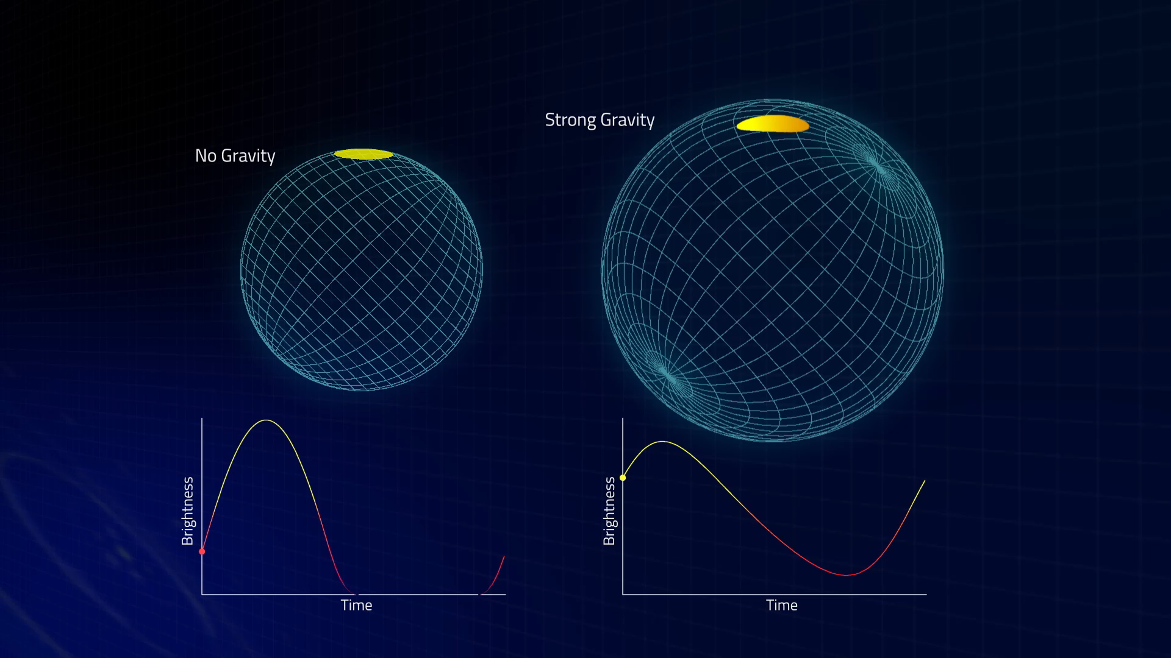
Pulse Profile Modelling
“ ”
Relativistic effects
Light bending
Doppler boosting
Higher M/R, spin ➔ More modulation
Morsink/Moir/Arzoumanian/NASA
Notes:
Hotspots – variety of reasons, see later slide
Strong gravity –
GR – light bending – poles, back of star – hotspot always in view, larger apparent size
Relativistic boosting – blueshifted side brighter, peak lum sooner
Peak intensity lower – photon climbs grav well – redshifted – energy drops
To deduce param, we need accurate phase info
Modulation increases as M/R increases, EoS dictates this ratio – model ST, we can obtain info on M,R

Slide 19

X-ray Pulse Simulation and Inference (X-PSI)
Instrument and data
Neutron star model
Statistical sampling
Neutron star parameters
https://github.com/ThomasEdwardRiley/xpsi
Notes:
The way we perform pulse profile modelling is by using XPSI which was developed by a senior of mine, and it’s something that I am currently using and helping develop further for a stable v1.0 public release.

Slide 20
X-PSI
Instrument and data
Neutron star model
Statistical sampling
Neutron star parameters

Slide 21

Neutron Star Interior Composition Explorer (NICER)
High sensitivity in soft X-ray band for observing rotation-powered pulsars.
High time and energy resolution
Notes:
Dedicated mission – obtain meaningful M,R
Designed for PPM, energy band and timing res

Slide 22


NICER data
Charged particles
Soft X-ray
Soft X-ray
Charged particles
Rotation-powered pulsars
nasa.gov
Notes:
RPP since stable pulses, less modelling assumptions – accreting sources, temporally variable
Effects are also dependent on energy, high energy resolution helps in calc

Slide 23
X-PSI
Instrument and data
Neutron star model
Statistical sampling
Neutron star parameters

Slide 24


Modelling – Relativistic Ray-tracing
Bogdanov et al. 2019b
Morsink et al. 2007
Emission geometry – inclination, emission angle and deflection angle
Deflection angle dependent on exterior spacetime
Oblate Schwarzschild + Doppler approximation
Notes:
Similar to video games, all the pretty graphics with light going through fog and getting reflected are simulated. We do the same but also have to account for relativistic effects
There are many aspects to this – touch upon imp ones, inclination of the system wrt observer, emission angle, deflection angle as registered by observer due to bent spacetime
Spacetime is rotating, so a static soln like Schwarzschild isn’t a good description. The exact solution is very computationally expensive. Approx used

Slide 25



Modelling – Spot Geometry
Riley et al. 2019
Single-temperature
Dual-temperature
Ring
Crescent
Notes:
For J0030 – increasingly complex spot models motivated by pulsar theory
Sizes made to vary, antipodal symmetry broken
Crescent – dual temp, portruding

Slide 26
X-PSI
Instrument and data
Neutron star model
Statistical sampling
Neutron star parameters

Slide 27

Baye’s Theorem
$π\left(θ | D,M \right) p\left(D | M\right)=p\left(D | θ,M \right) p\left(θ | M\right)$
posterior
evidence
likelihood
prior
Prior $p\left(θ | M\right)$: Educated guess, probability that our model is going to have certain parameters
Likelihood $p\left(D | θ,M \right)$: How likely is it to observe the data with such a parameterised model
Evidence $p\left(D | M\right)$: Normalization term – probability of the data given all sets of parameterization
Posterior $p\left(θ | D,M \right)$: Probability distribution of parameters given our data and model

Slide 28





Nested Sampling
$$θ_{2}$$
$$ℒ_{1}<ℒ_{2}<ℒ_{3}<ℒ_{4}$$
Cartesius Supercomputer
Computationally expensive
High Performance Computing
$$θ_{1}$$
F. Feroz, M.P. Hobson & M. Bridges 2009
Notes:
Obtain posterior by using the Bayesian inference code Multinest (MN)
MN performs Nested samples from n-dim param space – finds lowest-likelihood contours – samples from within
Iteratively finds the samples corres to maximum likelihood providing us the posterior
MN implements a clustering method that allows it to identify the presence of separate modes in likelihood

Slide 29
X-PSI
Instrument and data
Neutron star model
Statistical sampling
Neutron star parameters

Slide 30


Inference - PSR J0030+0451
Same Temperature
Earth
Riley et al. 2019
Notes:
Prior volume, 1-sigma, 2-sigma CI
Non-canonical form of hotspots

Slide 31


Inference - PSR J0030+0451
Notes:
Many params – about 20 for the final model in Riley et al.2019, things like spot geometry params, distance, ism etc

Slide 32



Inference - PSR J0030+0451

Slide 33



Present Work – PSR J0437-4715
J0030
J0437
Nearest observed MSP – tight distance prior, improved counts
Present in a binary – tight mass and inclination prior
Expected radius constraint $\sim ±2.5 \%$
Notes:
J0030 even though most precise simultaneous MR measurement, not good enough.
Stay tuned for J0437 results in the coming year

Slide 34


Scope of Future
PSR J0740+6620 – highest mass neutron star discovered
Accreting source observation by eXTP and STROBE-X
Combining GW data of NS merger to constrain EOS

